Slide 1
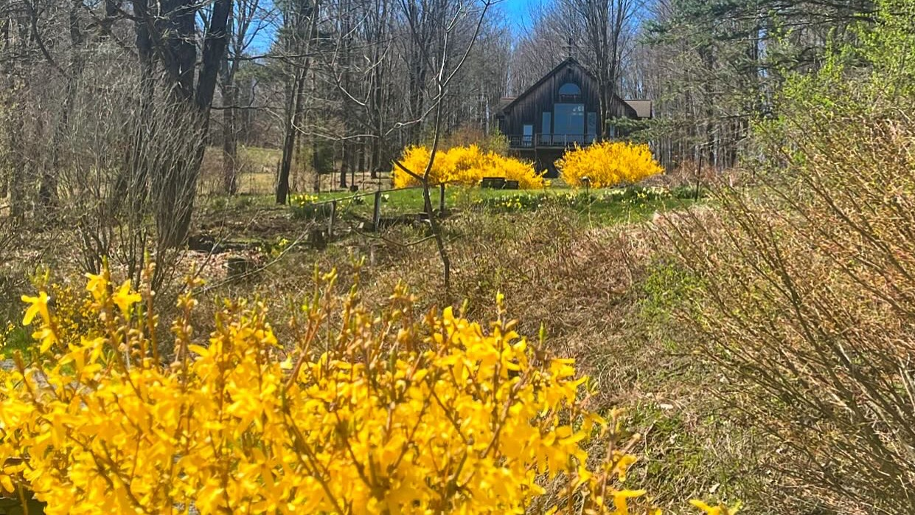


Slide 2



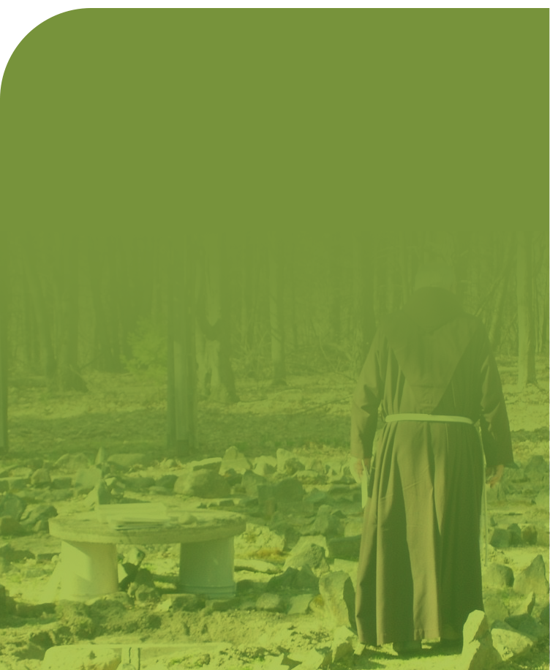
Three Peaks of Mt. Irenaeus
SERVICE TO
SBU STUDENTS
SERVICE TO ADULTS/
FAITH FORMATION
SERVICE TO
FRANCISCAN WORLD
Service primarily to the
St. Bonaventure University student community on campus and at the Mountain.
Adult outreach at the Mountain, On the Road, In the Home, through social media, content creation, formation pods and more.
A unique ministry within the Province of Our Lady of Guadalupe for friars to experience and be formed in contemplative life and ministry.
OUR CORE FOR 40 YEARS
MINISTRY WITH STRONG GROWTH
AREA OF STRATEGIC FOCUS

Slide 3

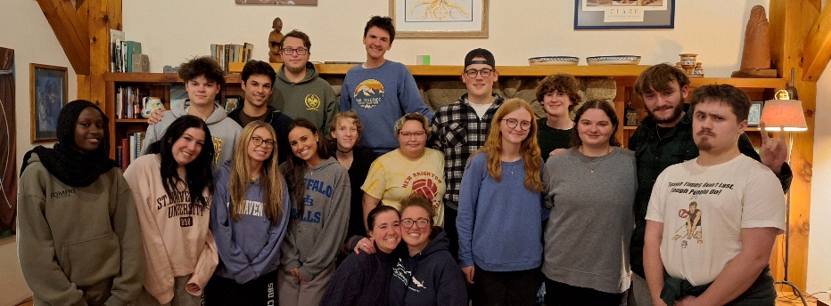

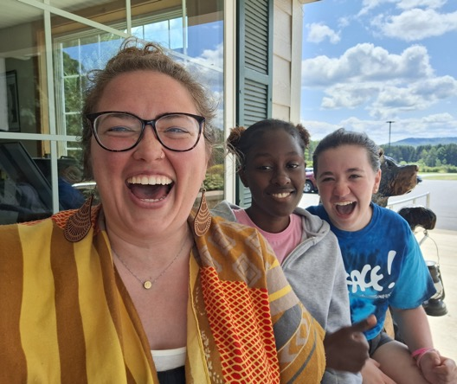
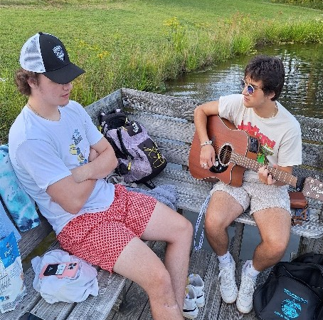
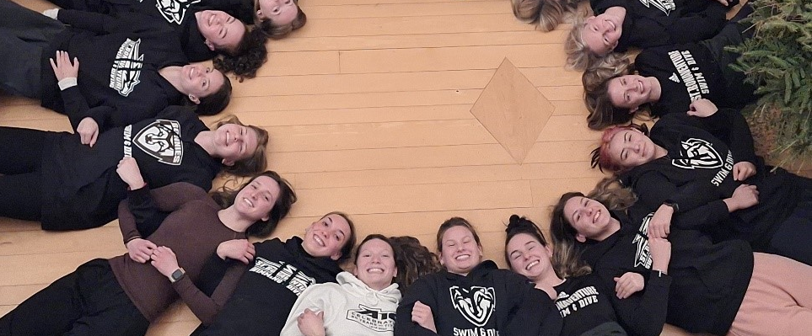
OUR CORE FOR 40 YEARS
Our Core Mission and First Peak:
Service to SBU Students
Mt. Irenaeus offers students hospitality, community, Franciscan spirituality, contemplation and care for creation
Planned by Ministry Coordinator Natalie Pronio (SBU ‘09)
Modeled by Mountain resident community of 3 friars, 2 lay women
Student engagement is strong!
~800+ student visits were recorded in the 2024-2025 academic year
~ 40 open events, overnights, team and club gatherings
Typical events include time on the land, preparing dinner and cleaning up together, reflection and prayer at the Chapel
60% women, 40% men
Student leadership and internship opportunities
Mt. Irenaeus partners closely with SBU and University Ministries
Variety of engagement opportunities for students on campus and off
The Mountain assists with programs for student recruitment and retention
Many joint events with University Ministries
Mt. Irenaeus-SBU Partnership Agreement renewed in 2024

Slide 4
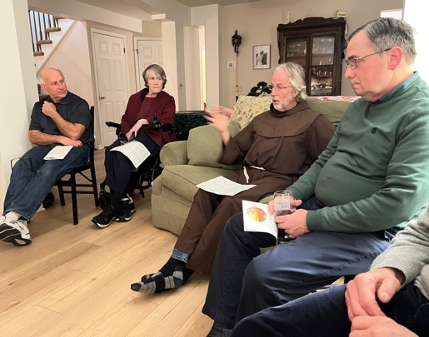
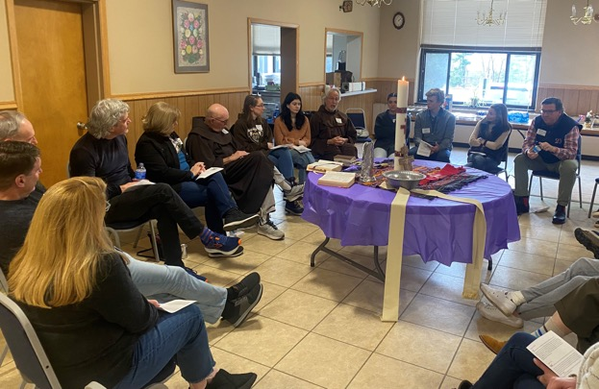

MINISTRY WITH STRONG GROWTH
SERVICE TO
SBU STUDENTS
Second Peak: Faith Formation, Service to Adults & Alumni
Mt. Irenaeus offers students hospitality, community, Franciscan spirituality, contemplation, and care for creation
Planned by Ministry Coordinator Natalie Pronio (SBU ‘09)
Modeled by Mountain resident community of 4 friars, 2 lay women
Student engagement is strong!
~800 students visited the Mountain this academic year 2024-2025
~ 40 open events, overnights, team and club gatherings
Typical events include time on the land, preparing dinner and cleaning up together, reflection and prayer at the Chapel
60% women, 40% men
Student leadership and internship opportunities
Mt. Irenaeus partners closely with SBU and University Ministries
Variety of engagement opportunities for students on campus and off
The Mountain assists with programs for student recruitment and retention
Many joint events with UMin
SBU Partnership agreement renewed in 2024
Outreach to adults, alumni, and the world, originally led by Fr. Dan Riley:
Council for Spirit & Life established in 2016
Co-led by Karen Pulaski (SBU ‘84), Director of Faith Formation & Mountain community resident
Fr. Dan’s “Franciscan Lectio” published in 2022
At the Mountain:
Weekly masses and brunch, lectio and prayer
Overnight retreats and evenings of recreation
Special programs on social justice, Franciscan faith in action, and faith exploration experiences
Next steps: “Everything Belongs” branch starting on civil discourse
Next steps: Expansion of women's retreats and other adult offerings
Mountain on the Road - Launched in 2001, 40+ U.S. locations
Partner with SBU Alumni Engagement team
2-4 SBU students travel “on the road” develop leadership skills as part of ministry
Br. Joe Kotula, Karen Pulaski, Mike Fenn, Joe Flanagan continue
Mountain in your Home – Hosted in private homes since 2009, open to all
Next steps: Networks across the country
Faith Formation – sharing Franciscan charism using “Build w/ Living Stones” text
55 participants in 2024 met in small groups on Zoom for 14 months
Next Steps: Expanding to new groups, both virtual and in person, starting September 2025 in collaboration with the Province of Our Lady of Guadalupe
Podcasts (nearly 300) and frequent social media posts available to the world
Next Steps: Digital Franciscan Library with digital resources available to all

Slide 5
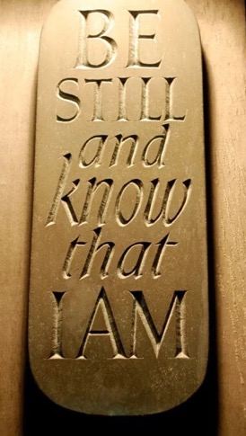
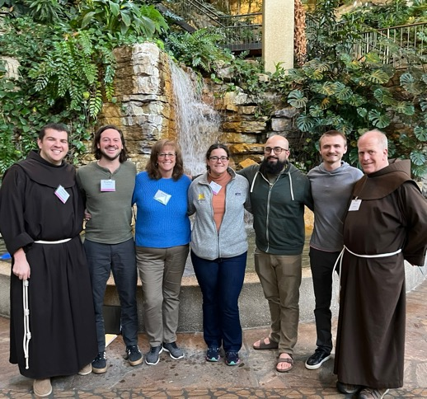
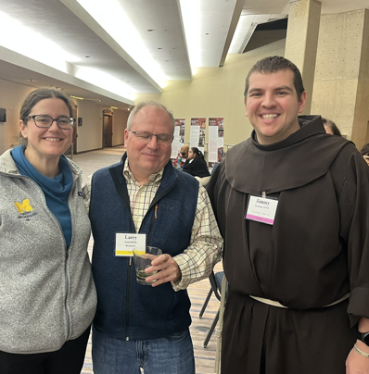

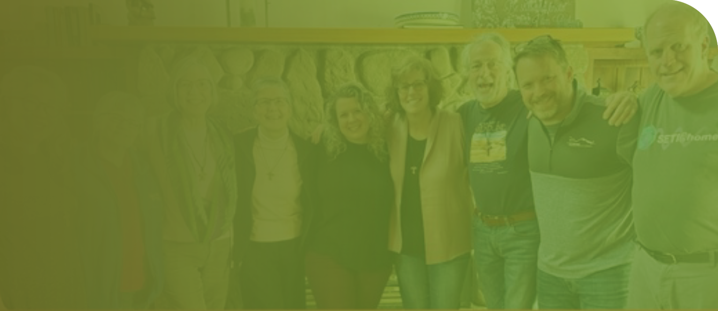
AREA OF STRATEGIC FOCUS
SERVICE TO
SBU STUDENTS
Third Peak:
Service to Franciscan world
Mt. Irenaeus offers students hospitality, community, Franciscan spirituality, contemplation, and care for creation
Planned by Ministry Coordinator Natalie Pronio (SBU ‘09)
Modeled by Mountain resident community of 4 friars, 2 lay women
Student engagement is strong!
~800 students visited the Mountain this academic year 2024-2025
~ 40 open events, overnights, team and club gatherings
Typical events include time on the land, preparing dinner and cleaning up together, reflection and prayer at the Chapel
60% women, 40% men
Student leadership and internship opportunities
Mt. Irenaeus partners closely with SBU and University Ministries
Variety of engagement opportunities for students on campus and off
The Mountain assists with programs for student recruitment and retention
Many joint events with UMin
SBU Partnership agreement renewed in 2024
Mt. Irenaeus offers a unique ministry within the Province of Our Lady of Guadalupe:
The new Province asked all friars to make a contemplative retreat within 3 years
Mt. Irenaeus is among only a handful of options for these sort of retreats
Friars and other religious are joining contemplative retreats at the Mountain, led by Br. Kevin Kriso, ofm
Mt. Irenaeus collaborating with Province to lead national Build with Living Stones prayer and formation pods
Mt. Irenaeus has been fertile ground for Franciscan vocations:
Of the 29 men currently in Franciscan formation programs nationally, 7 have spent significant time at the Mountain.
Four of the seven are recent SBU graduates: Fr. Jason Damon ‘16, ofm, Br. Jimmy Kernan ’19, ofm, Br. Tyler Grudi ‘19, ofm, and Br. Kevin Hamzik ‘19, ofm.
Mt. Irenaeus friars and community members have participated in the 2-year synod work of the newly created nationwide Province.
Mt. Irenaeus was the only Franciscan fraternity invited to bring 3 lay people to the national Provincial Synod held in January 2025 in Kansas City
Br. Kevin Kriso, ofm, Karen Pulaski, and friends of the Mountain Dr. Allie Leis ‘13 and Franciscan Media author Stephen Copeland participated.
Relationships are cultivated and maintained with other Franciscan organizations:
Franciscan Federation
Association of Franciscan Colleges and Universities
Franciscan Action Network
Center for Action & Contemplation (Fr. Richard Rohr, ofm)

Slide 6
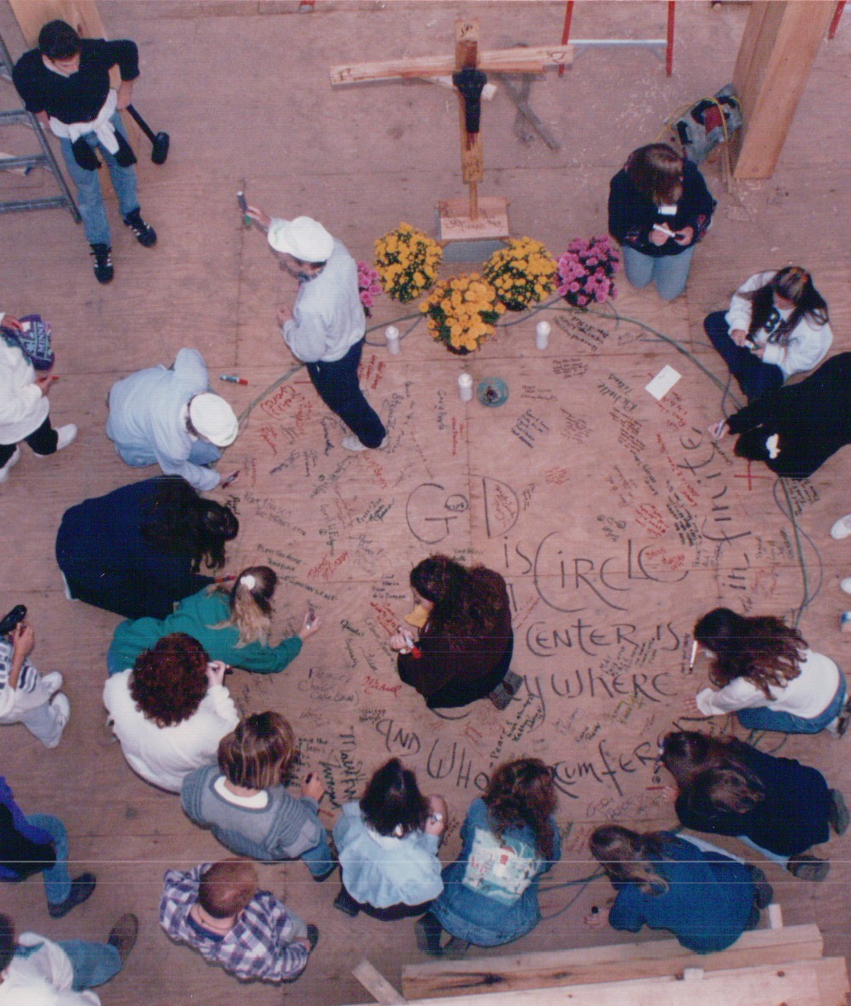
We are in a phase of growth, requiring added resources
We look to expand our capacity to invite others into our community – friars and laity--short and long term stays.
Our three peaks note an expansion of ministry, which requires bringing others in to carry out what we are called to do.
We look to build greater financial stability
While secure in our present state, revenue sources including the Mountain Fund, Auction, Overnights, Investment Income and SBU contribution are unlikely to grow substantially in future years.
We want to take a more conservative percentage draw from our endowment.
WHY DOES
THE MOUNTAIN NEED TO INCREASE ITS ENDOWMENT?

